Slide 1
Objectives
To introduce the notion of a thread — a fundamental unit of CPU utilization that forms the basis of multithreaded computer systems
To discuss the APIs for the Pthreads, Win32, and Java thread libraries
To examine issues related to multithreaded programming

Slide 2
Motivation
Threads run within application
Multiple tasks with the application can be implemented by separate threads
Update display
Fetch data
Spell checking
Answer a network request
Process creation is heavy-weight while thread creation is light-weight
Can simplify code, increase efficiency
Kernels are generally multithreaded

Slide 3
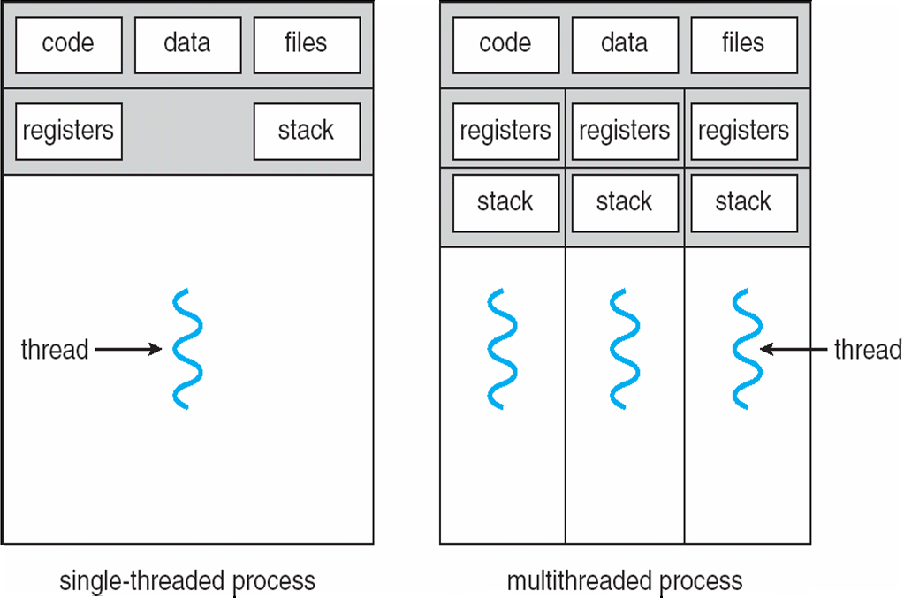
Single and Multithreaded Processes

Slide 4
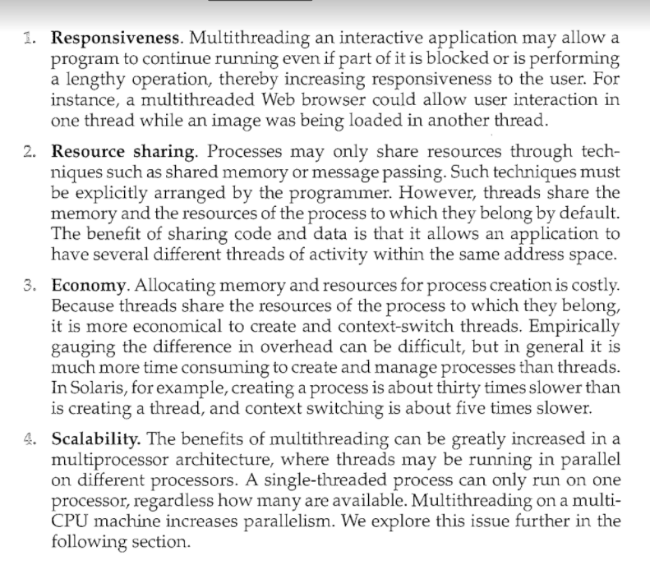
Benefits

Slide 5
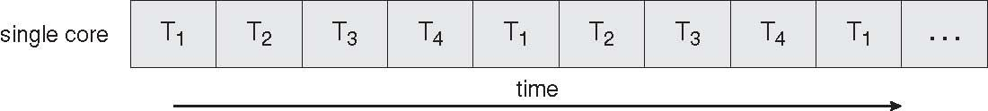
Concurrent Execution on a Single-core System

Slide 6
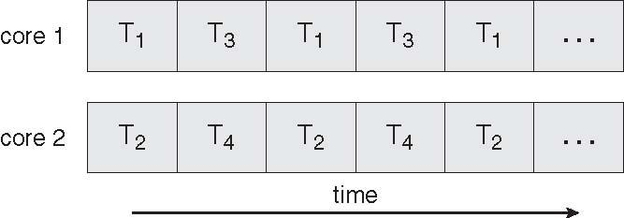
Parallel Execution on a Multicore System

Slide 7
User Threads
Thread management done by user-level threads library
Three primary thread libraries:
POSIX Pthreads
Win32 threads
Java threads

Slide 8
Kernel Threads
Supported by the Kernel
Examples
Windows XP/2000
Solaris
Linux
Tru64 UNIX
Mac OS X

Slide 9
Multithreading Models
Many-to-One
One-to-One
Many-to-Many

Slide 10
Many-to-One
Many user-level threads mapped to single kernel thread
Thread management is done by the thread library in user space,so it is efficient
The entire process will block if a thread makes a blocking system call.
Examples:
Solaris Green Threads
GNU Portable Threads

Slide 11
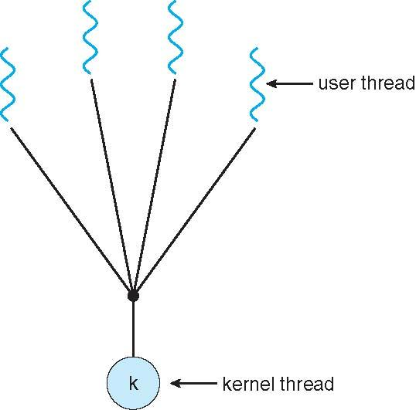
Many-to-One Model

Slide 12
One-to-One
Each user-level thread maps to kernel thread
Provides more concurrency than the many to one model by allowing another thread to run when a thread makes a blocking system
Also allow multiple threads to run in parallel on multiprocessors
Creating a user thread requires creating the corresponding kernel thread
Examples
Windows NT/XP/2000
Linux
Solaris 9 and later

Slide 13
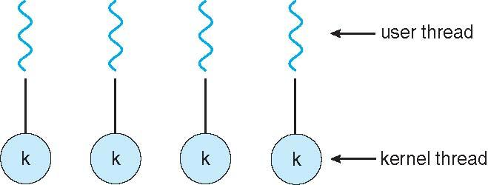
One-to-one Model

Slide 14
Many-to-Many Model
Allows many user level threads to be mapped to many kernel threads
Allows the operating system to create a sufficient number of kernel threads
Solaris prior to version 9
Windows NT/2000 with the ThreadFiber package

Slide 15
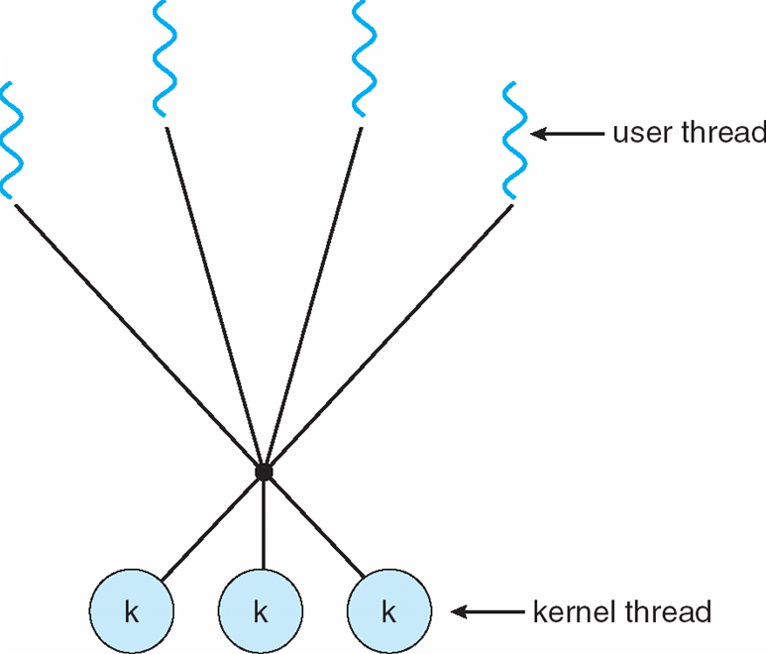
Many-to-Many Model

Slide 16
Thread Libraries
Thread library provides programmer with API for creating and managing threads
Two primary ways of implementing
Library entirely in user space
Kernel-level library supported by the OS

Slide 17
Pthreads
May be provided either as user-level or kernel-level
A POSIX standard (IEEE 1003.1c) API for thread creation and synchronization
API specifies behavior of the thread library, implementation is up to development of the library
Common in UNIX operating systems (Solaris, Linux, Mac OS X)

Slide 18
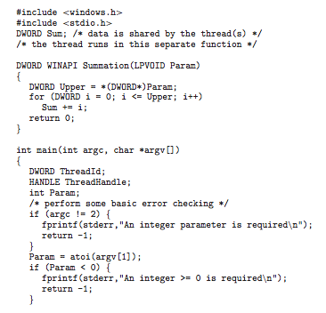
Win32 API Multithreaded C Program

Slide 19
Java Threads
Java threads are managed by the JVM
Typically implemented using the threads model provided by underlying OS
Java threads may be created by:
Extending Thread class
Implementing the Runnable interface

